Slide 1



Group 3 Hari Prasath Jothiswaran
Gnan Srivarsh Bekkesula Narahari
Yashwanth Majji
Yi-Hsuan Chan
Renukalaxmi Dudhe
Jiderechukwu Becky Ogbodo

Slide 2

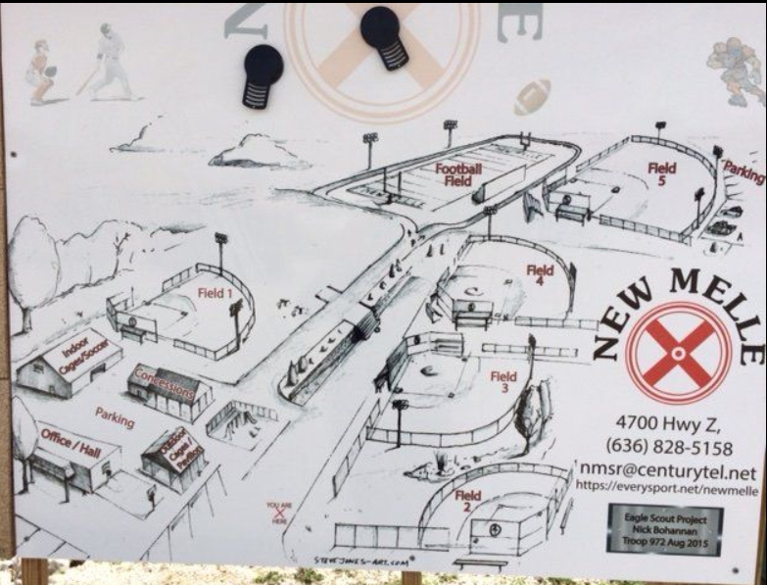
RECAP
NEW MELLE SPORTS AND RECREATION :
FORMERLY WE DISCUSSED ABOUT
STRENGTH
WEAKNESS
OPPORTUNITIES
THREATS
ALSO, CAPACITY ANALYSIS AND
DEMAND FORECASTING

Slide 3
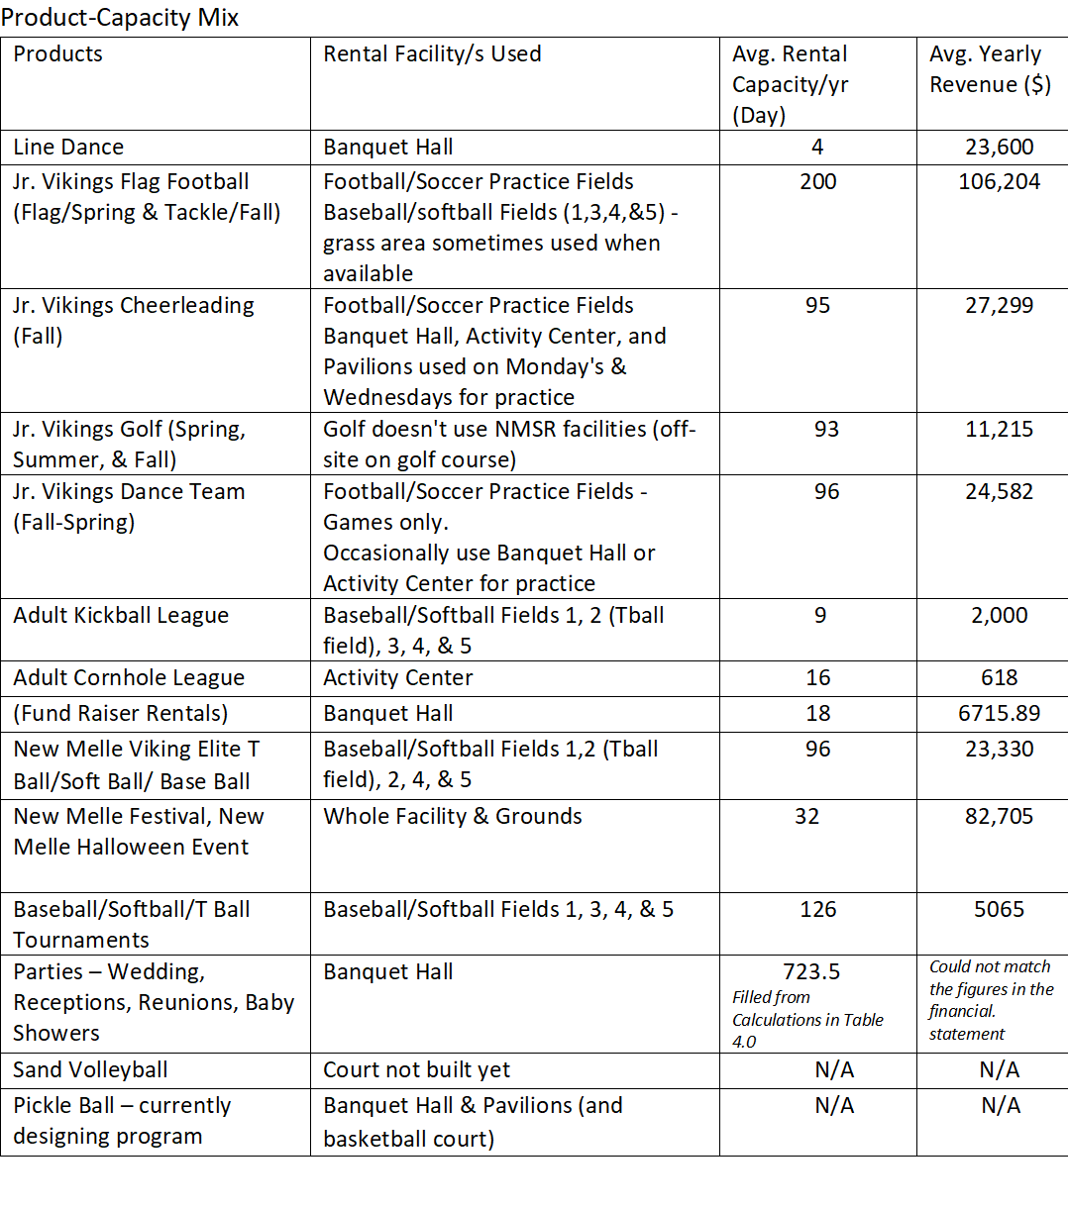

Slide 4

FOLLOWED BY
PROCESS IMPROVEMENT AND OPERATIONS
SUPPLY CHAIN AND OPERATIONS MANAGEMENT
SUPPLIER MANAGEMENT
RECOMMENDATIONS
CONCLUSIONS

Slide 5
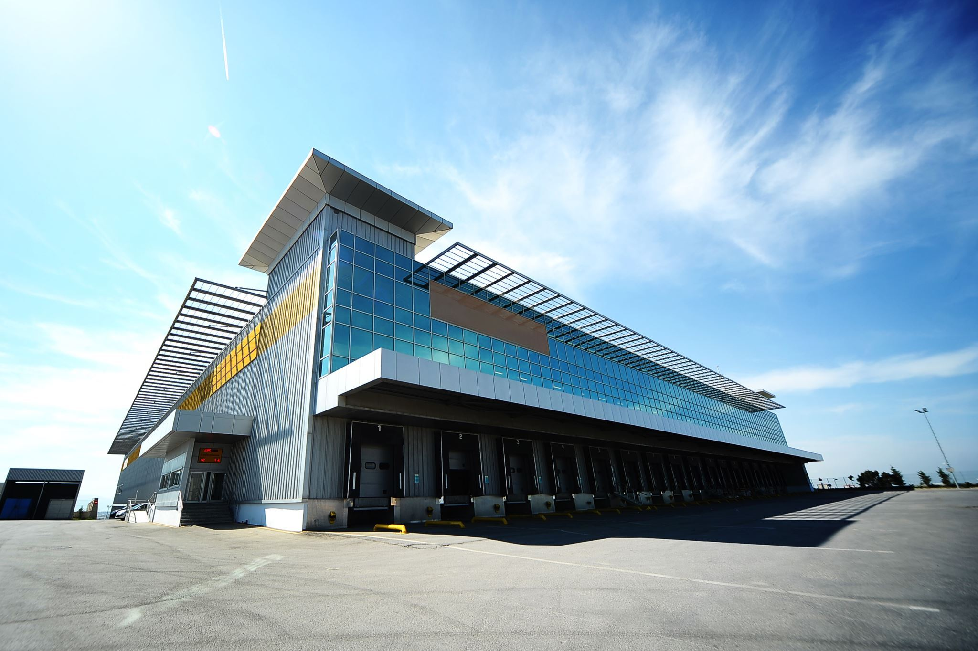
Process Improvement & Operations
Process improvement: Refers to the systematic approach of analyzing and optimizing the existing business process to improve efficiency, reduce waste, and increase productivity.
Operations: Refers to day-to-day activities that enable a business to function. It include operations such as manufacturing, sales, marketing, distribution, and customer service.
Process improvement is an essential part of operations management, as it helps to identify the inefficiencies and bottlenecks which impacts the operations.
Several areas and operations in the NMSR needs improvements such as
- Disability access,
- Provision of air conditioning units in the batting cages,
- Upgrading the scheduling software,
- Provision of lights for the football field,
- Improvements on the concession stand operation and process.
This project mainly focuses on the improvements of lights on the football field and improvements on the concession stand operations.

Slide 6
5 Why's and answers Why Football fields needs the lights
New Melle Sports and Recreation currently has outdoor lights on only half of the park and the Football Field is not covered with the light
The lack of outdoor light causes vision constraints and is needed to improve vision and overall safety, Installing proper lighting can improve visibility and reduce the likelihood of accidents.
The installation of the outdoor lights will increase playing hours and would able to host the evening games, events and at the same time increase revenue.
Installation of the outdoor lights will help in meeting the demand and potentially might be able to attract new customers.
The installation of outdoor lighting can enhance the overall game experience. As high-quality, lightning gives an immersive experience for players and spectators too.

Slide 7
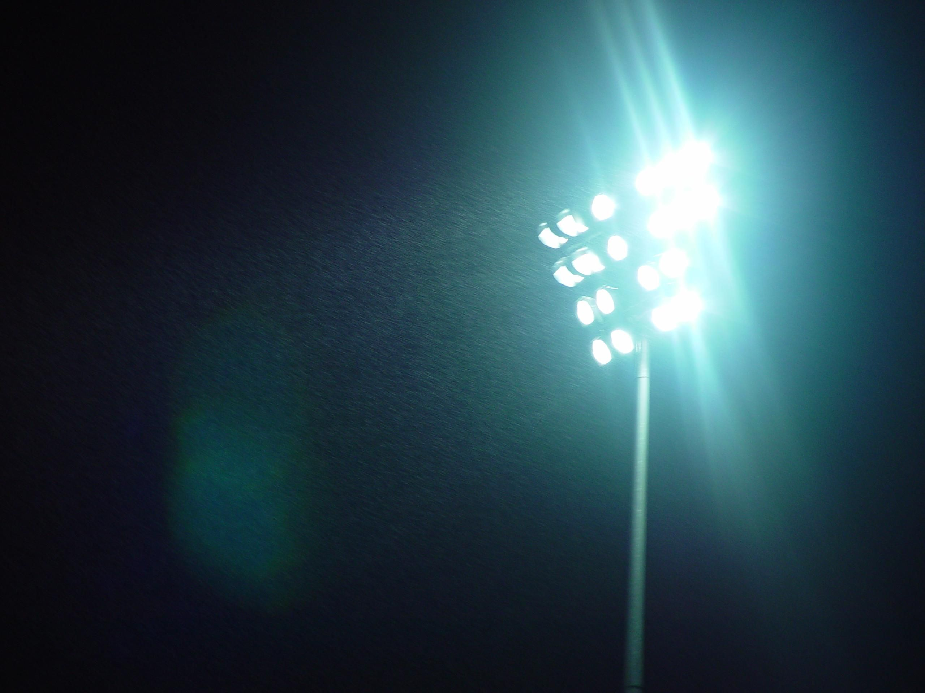
Return On Investment (ROI) for the Installation of LED light fixtures and mounting brackets on the Football Fields
(ROI) is a financial metric used to evaluate the profitability of an investment or project
ROI = Return (Benefit)/Investment (Cost)
Football Field 2022 Income = $106,204.25
Football Field 2022 Expenses = $63,069.86
Football Field 2022 Net Income = $106,204.25 - $63,069.86
=$43,134.39
Proposed Investment = $27,991.00+$89,571.00
= $117,562.00
(From quotation provided by American Electric & Data, Inc.)
ROI = ($43,134.39/$117,562.00) x 100
= 36.69%
This Photo by Unknown author is licensed under CC BY-SA.

Slide 8

Payback Period on the Investment for the Installation of LED light fixtures and mounting brackets on the Football Fields
Payback period = Initial Investment / Annual Net Income
Payback period = $117,562.00 / $43,134.39
= 2.72 years
Additional Metrics:
Net Present Value (NPV) and Internal Rate of Return (IRR)
NPV is a measure of the net present value of future cash flows, discounted at the required rate of return-
NPV = -$17,062.49
IRR is the rate at which the NPV of the investment is zero
IRR = 8.5%

Slide 9
GRANT
MLB-MLBPA Youth Development Foundation Grant
Funding Category includes-
Capital projects :include field renovations and installing lighting.
Baseball/Softball programs :cover in-school/after-school game programming, equipment, uniforms and player registration fees practice facility rental fees.
Education initiatives: include programs, exhibits and other learning opportunities that use baseball and softball as its primary focus to promote interest and engagement in the game
Accepts Letter of Inquiry submissions on a rolling basis throughout the year with no deadlines and grant decisions are made by its Board of Directors on a quarterly basis.
Contact : Email YDF@mlb.com or call (212) 931-7886
2) The National Recreation and Park Association (NRPA) Grant
Deadline: March 31
3) Snee-Reinhardt Charitable Foundation Grant
Deadline: Second Tuesday in May
Second Tuesday in September

Slide 10
Supply Chain/Operations Management
Inventory Management/Pricing
Define Inventory Mangement and Pricing
Briefly mention departments at New Melle’s that manages inventory
Menu
Cost to purchase
Price NMSR sells the menu
Compare other concession stand

Slide 11
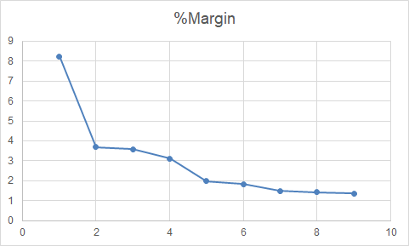
Margin Line Graph
This Graph shows there is so much variation in the sample margin data that is not normally distributed.

Slide 12
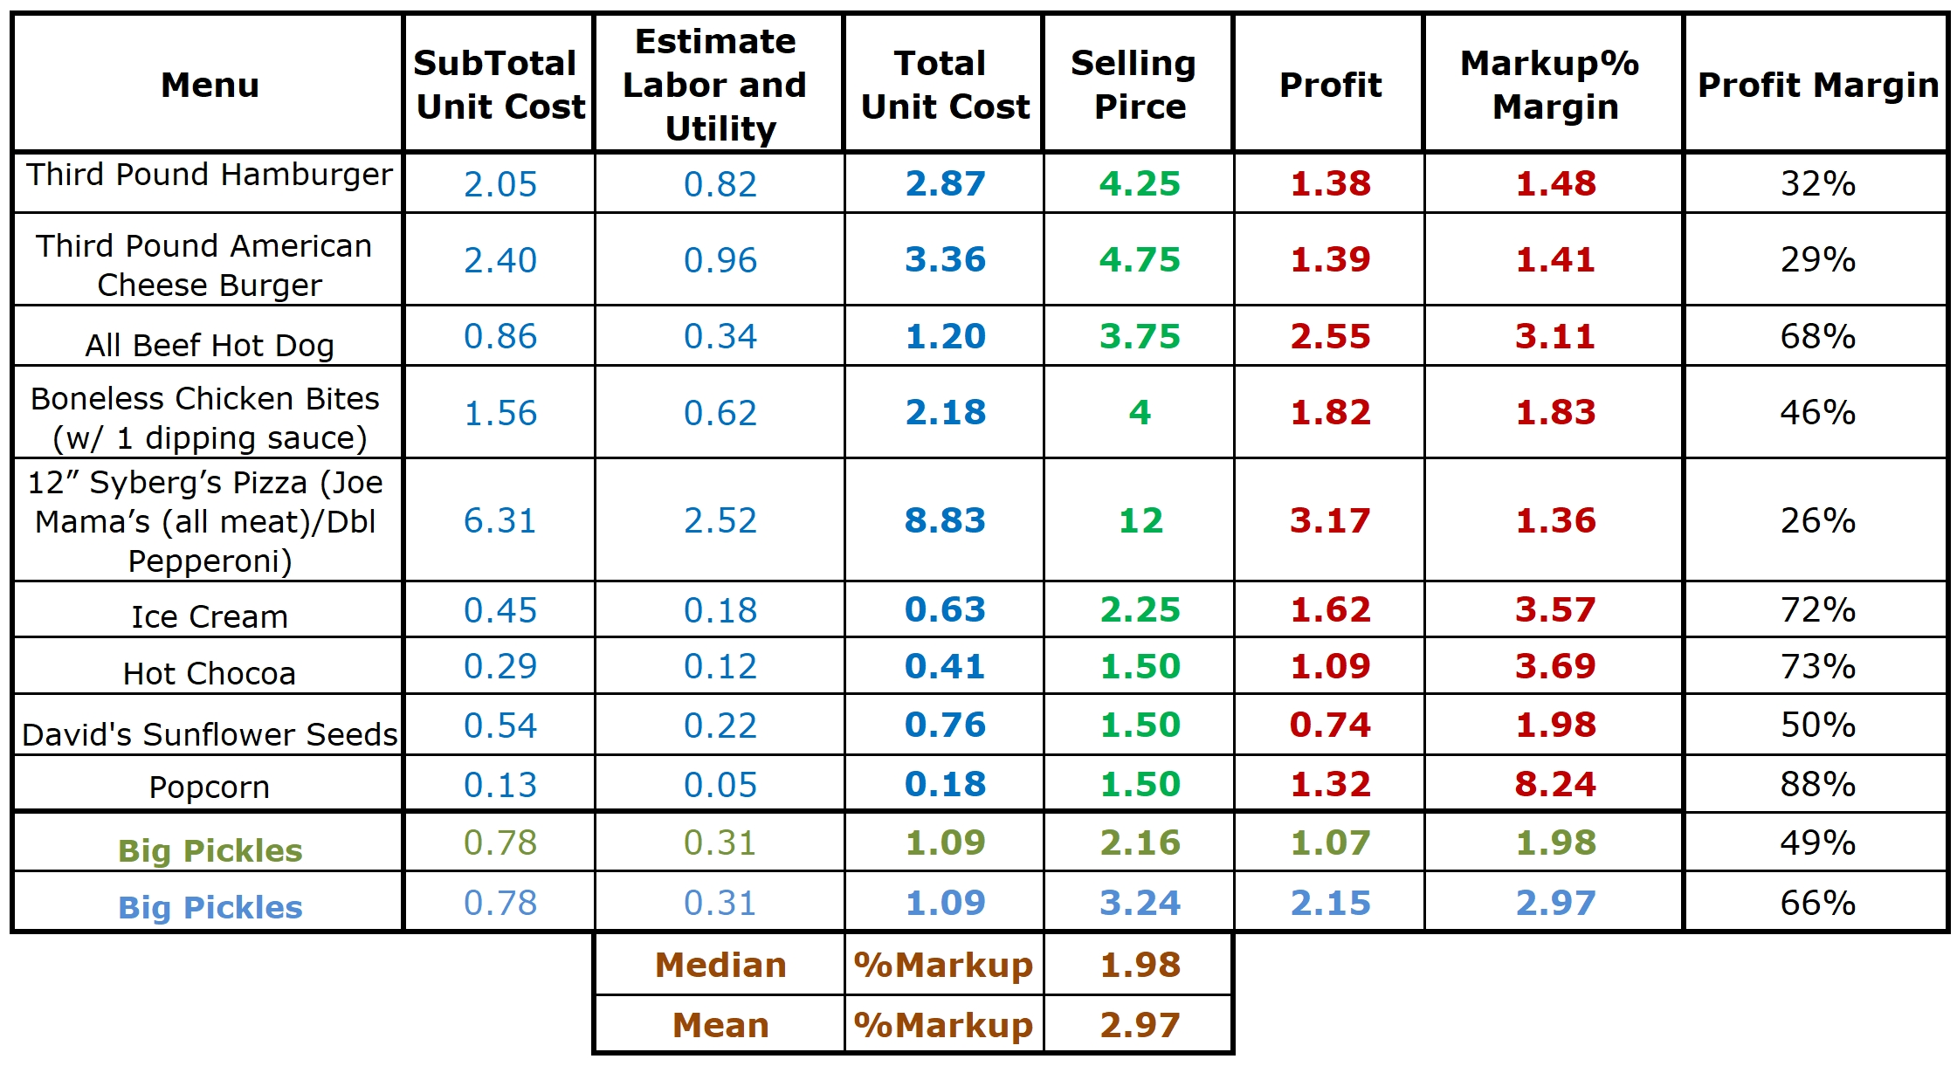
NMSR Menu, Cost and Price Analysis

Slide 13
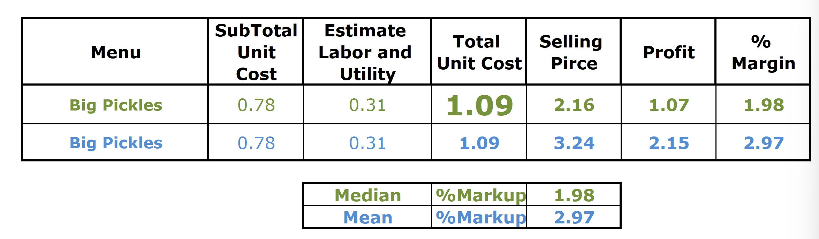
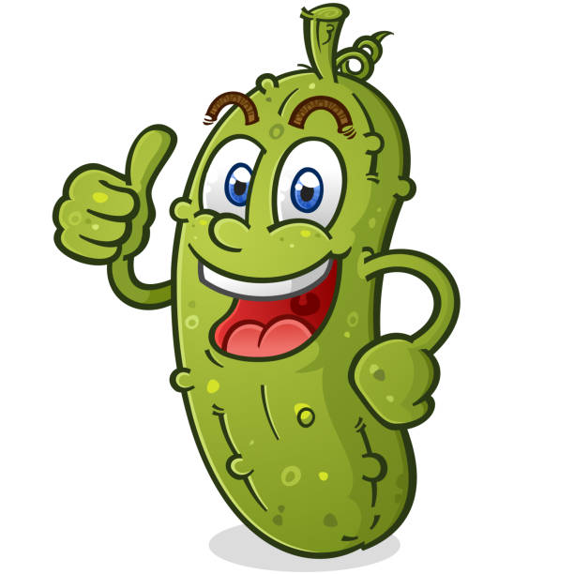
Additional Menu Analysis
Our recommended Price for the Pickle is ($1.09 x 8 = $8.72) $8.72 for one serving of (2oz) 8 pickles.
At this price, 12 Pickles = $13.08 < $13.37 with 12 individually packaged pickles

Slide 14
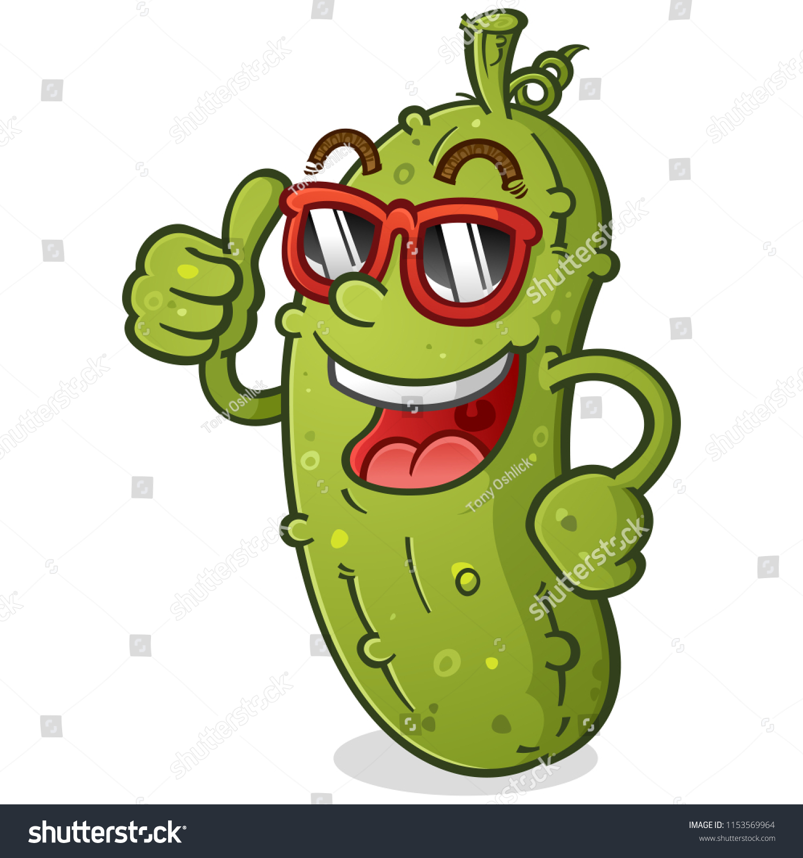
Additional Menu Analysis-Recommendation
Overall, we’d recommend the bucket pickle because the average cost is lower. Yet...
Pros for individual packed pickle:
1.) The price difference is little.
2.) It’s prepacked -> less labor cost.
3.) It can be stored at room temperature, which is great for our limited refrigerator space.

Slide 15
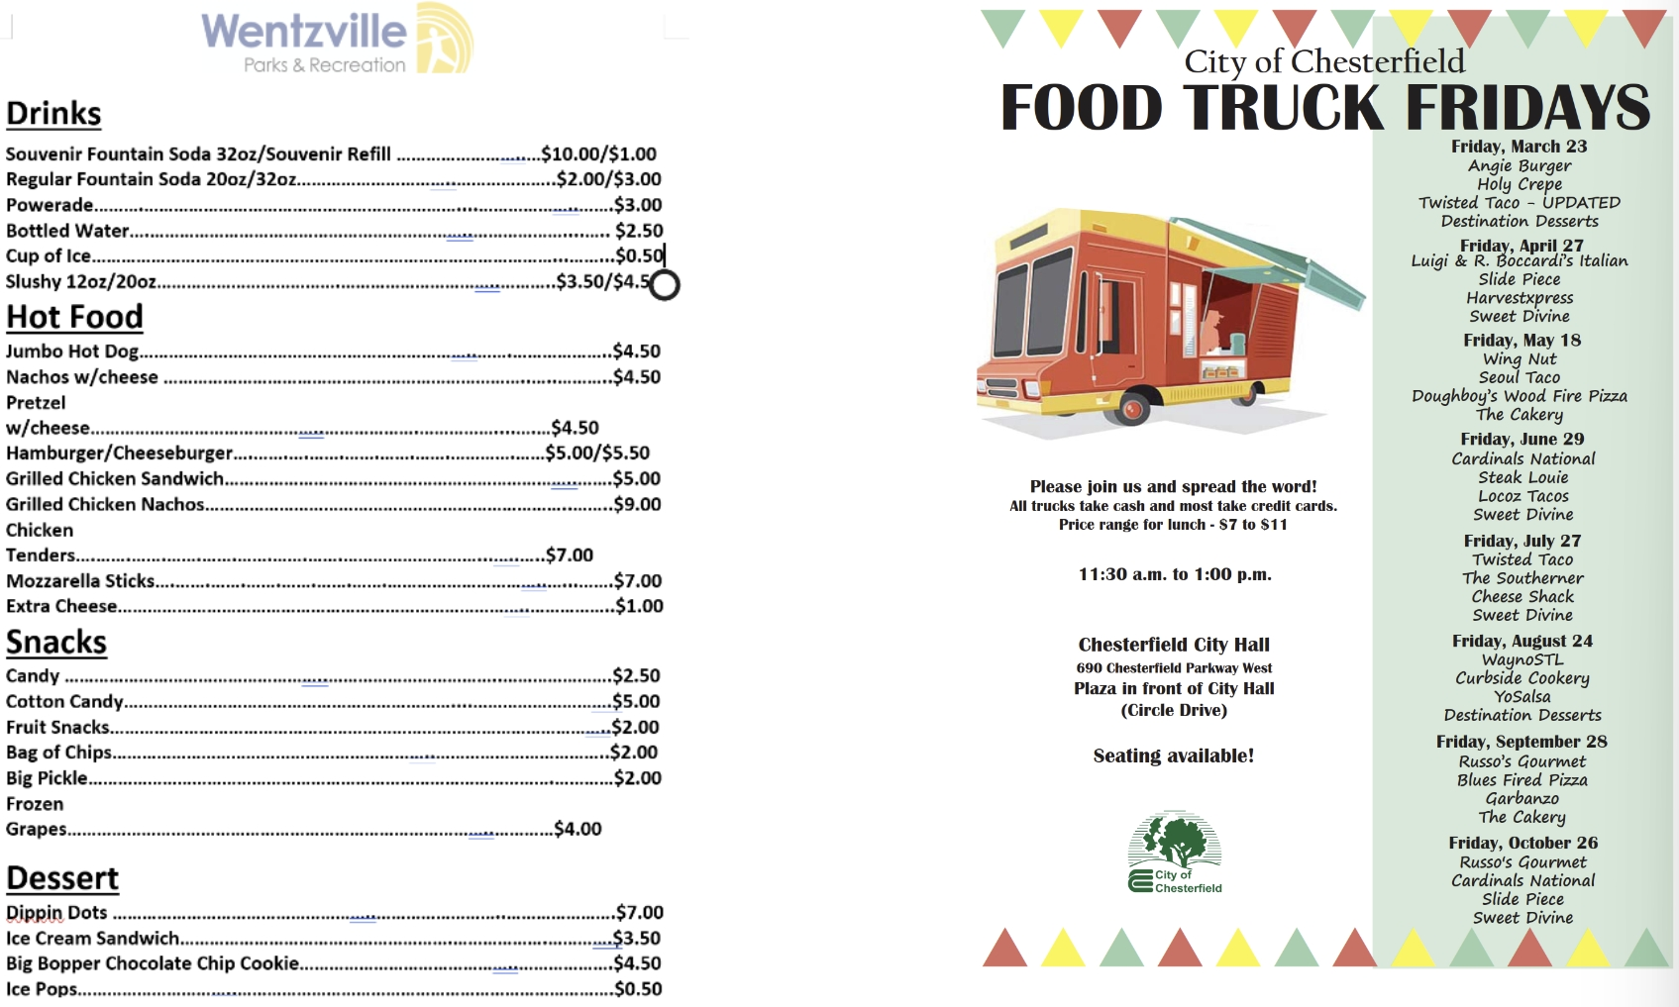
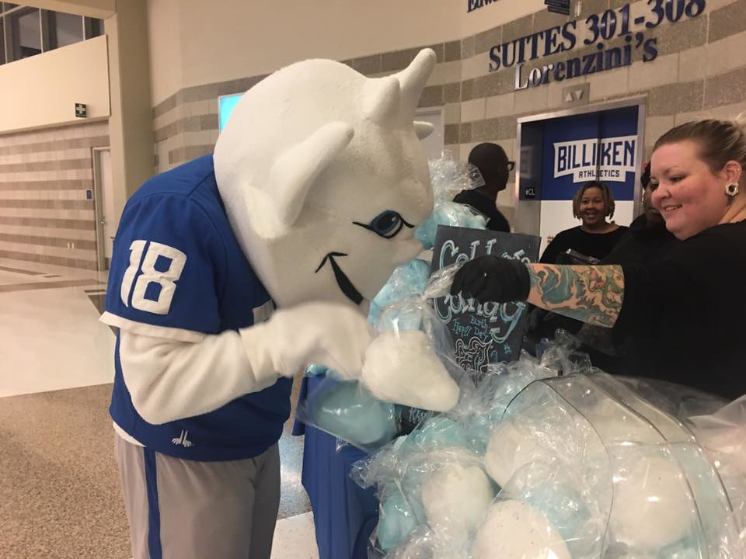









Competitor Product Analysis and Sales Review
This is the price information from a merchant website that sells similar cotton candy. They even sold cotton candy in SLU

Slide 16
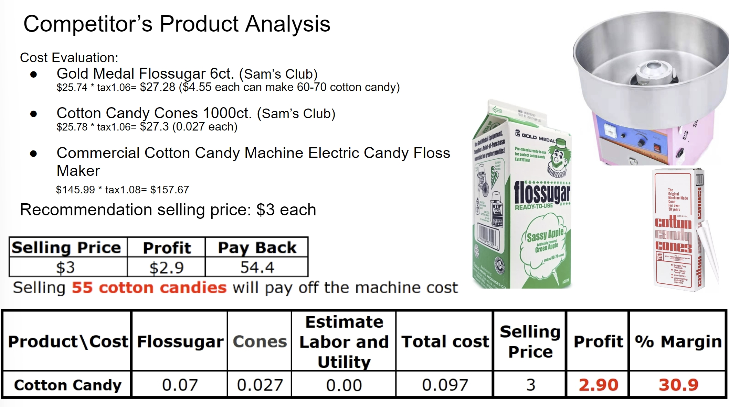

Slide 17
Supplier Management
Bullwhip Effect: Pepsi's online ordering option may lead to the bullwhip effect, causing inventory and supply chain issues.
Inventory Issue with Campbell Soup: The center may face inventory issues due to Campbell's ordering approach.
Material Storage of Ice Cream Cups: The center may need to explore alternative suppliers or consider making ice cream cups from scratch in case of a material shortage.
Late Delivery: The center may have to purchase similar items from local stores or inform customers of out-of-stock items if there is a delay in delivery.
Slush: A contingency plan is necessary to address stockouts of this irreplaceable item.
Accuracy of Orders: The beer company requires a 100% accurate order, which calls for clear communication channels with suppliers and accurate information on order quantities and specifications.

Slide 18
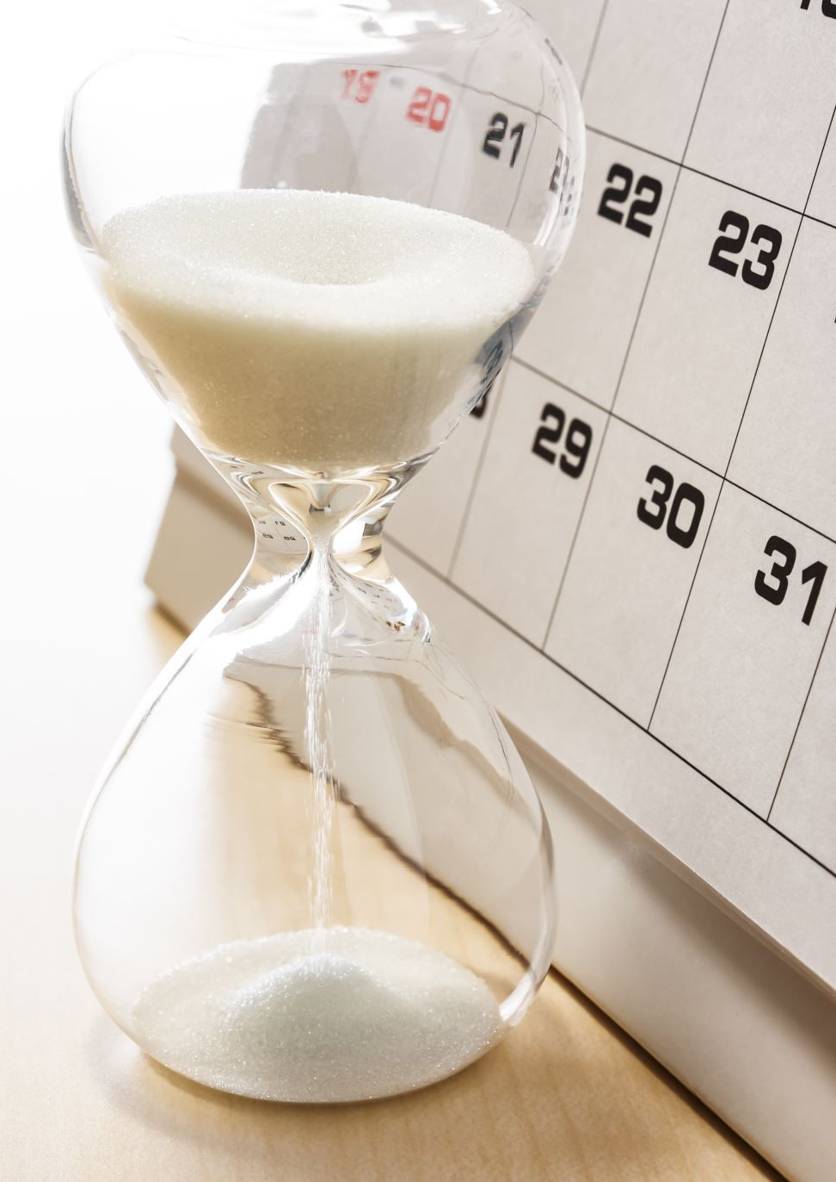
Food order lead time: 3 days
Slush lead time: 1 day
Pepsi's lead time: 2 weeks
If don’t get Minimum order, need to wait or pickup by ourselves

Slide 19
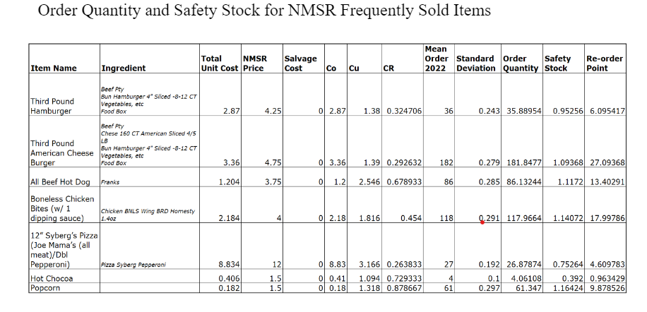

Slide 20

RECOMMENDATION
Efficiency of the Concession Stand can be improved by:
Knowing How Much to Order
Knowing how much safety stock is needed
Knowing when to Order
New Products need to be introduced to the concession to increase revenue.
Cotton Candy with 300% profit margin is highly recommended
Bucket Pickels is also recommended in place of individually packaged
Investment for Led Lights Fixtures and Mounting brackets in the football field is not very feasible. A grant can help reduce the payback period.
MLB-MLBPA Youth Development Foundation Grant is highly recommended, and application is on rolling basis.

Slide 21
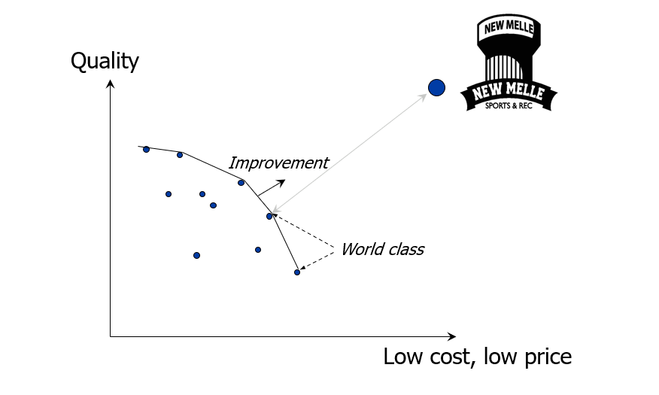
CONCLUSION

Slide 22
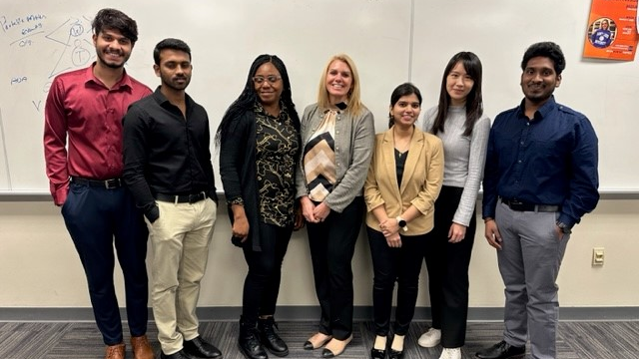
THANK YOU

